Slide 1


Cause of Death Report
Nagavenkateswara Rao Illa

Slide 2



Agenda
Introduction
DataSet Info
Data Analysis
Graphical Representations
Conclusions

Slide 3




Imporitng Libaries
In [1]: import pandas as pd import numpy as np import matplotlib.pyplot as plt import warnings warnings.filterwarnings('ignore') import seaborn as sns import plotly.express as px

Slide 4

Topic one
Loading Dataset

Slide 5
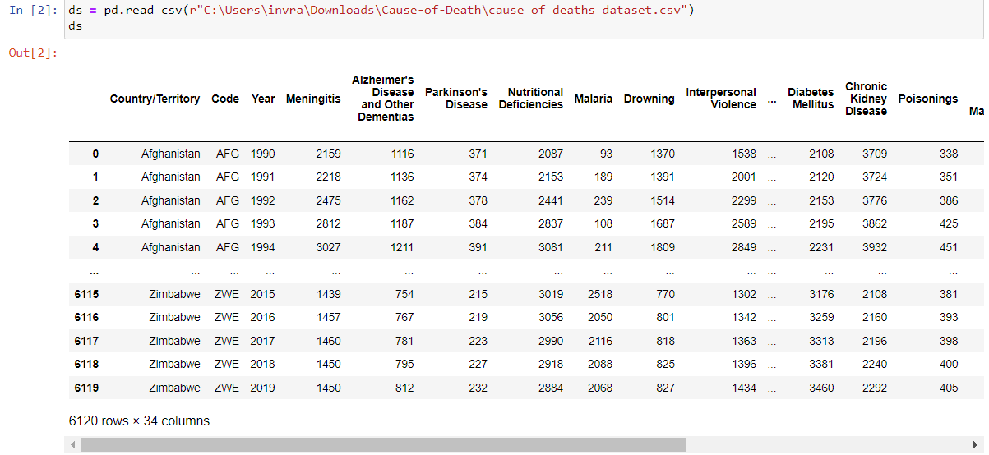
Loading The Dataset

Slide 6
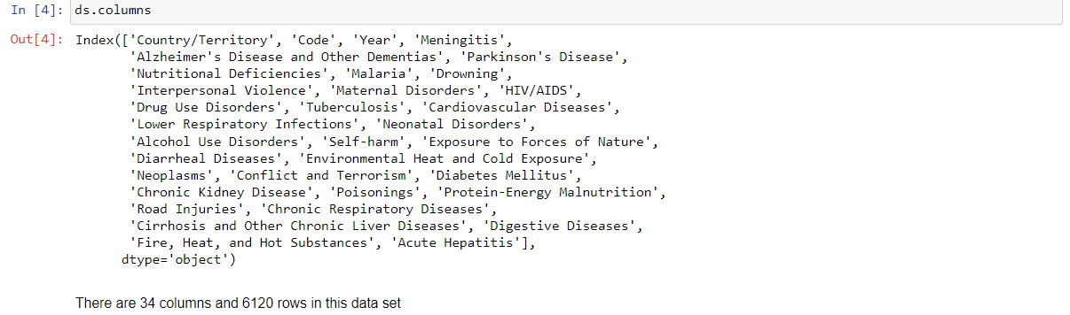
DataSet Info

Slide 7
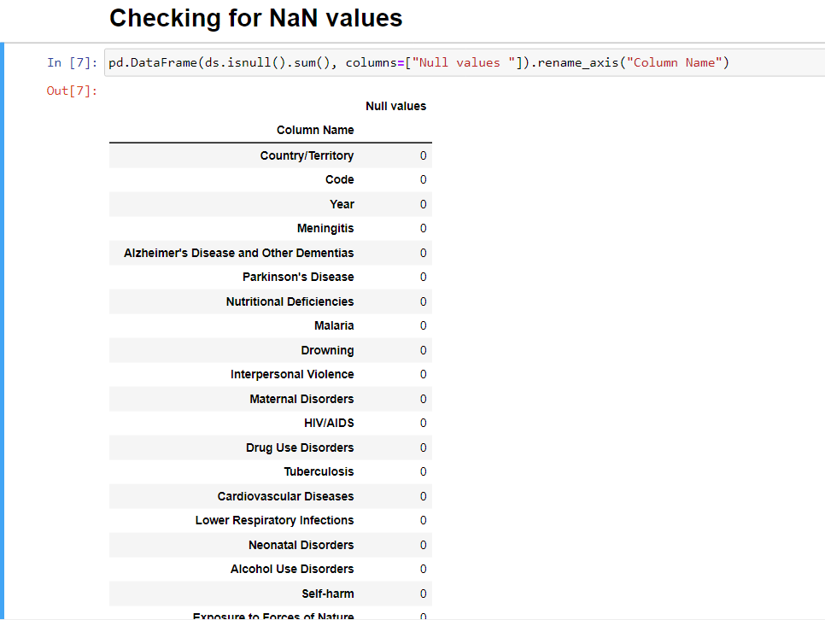

Checking for Null Values

Slide 8
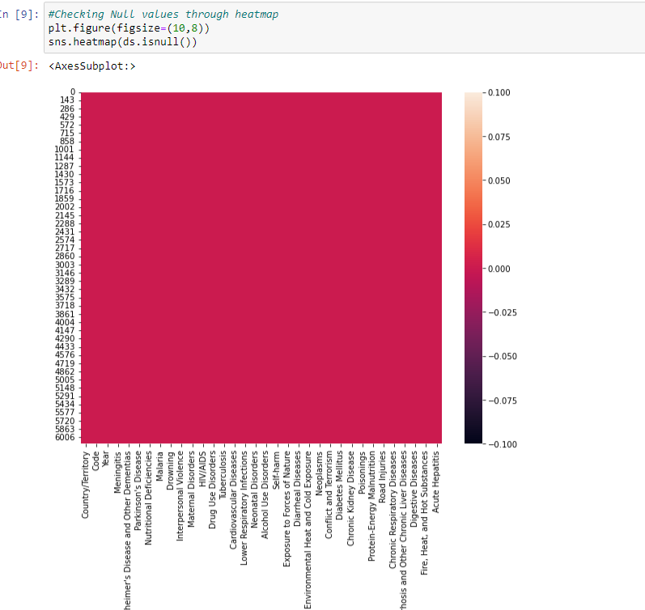
Null values Heat Map

Slide 9
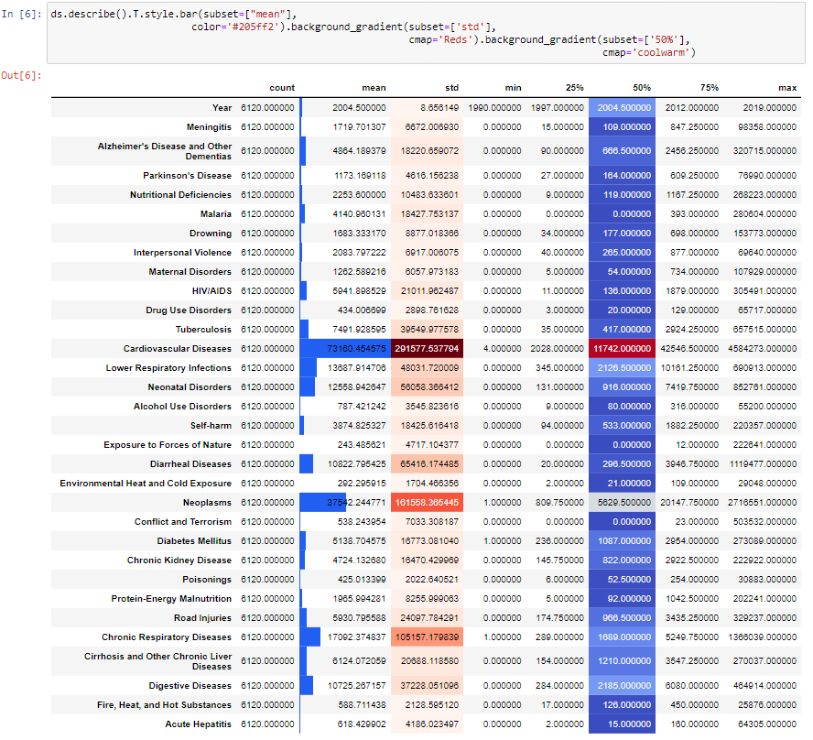
Data Analysis
Here we found that the Exposure to natural forces is having the least mean and the cardio vascular disease deaths is having the highest and much more than the any other cause. Neoplasms is the second leading cause of death all over the world.

Slide 10

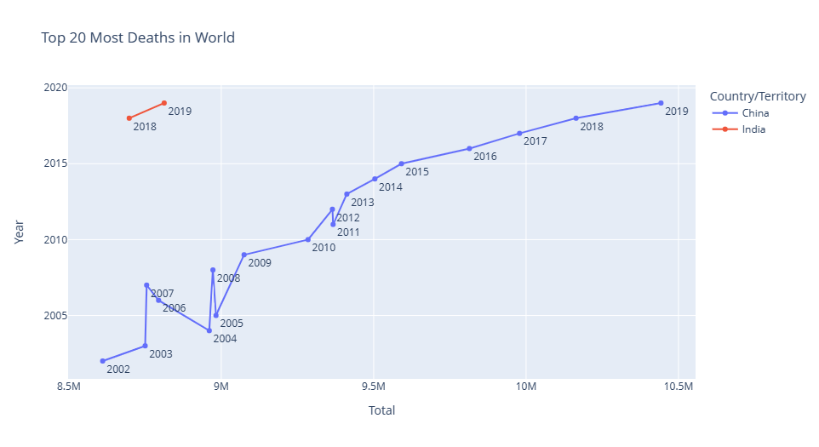
Top 20 Most Death Counts

Slide 11

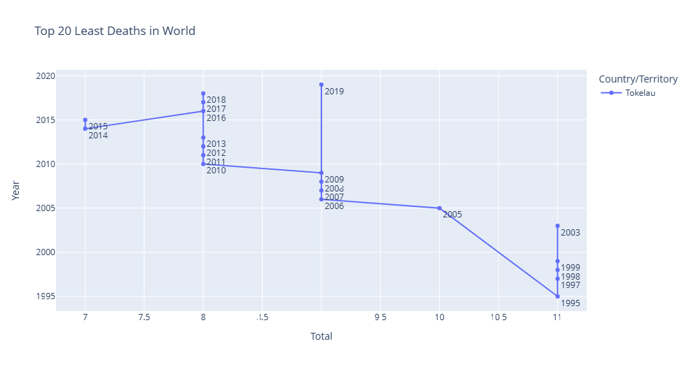
Last 20 Countries with Death Count

Slide 12
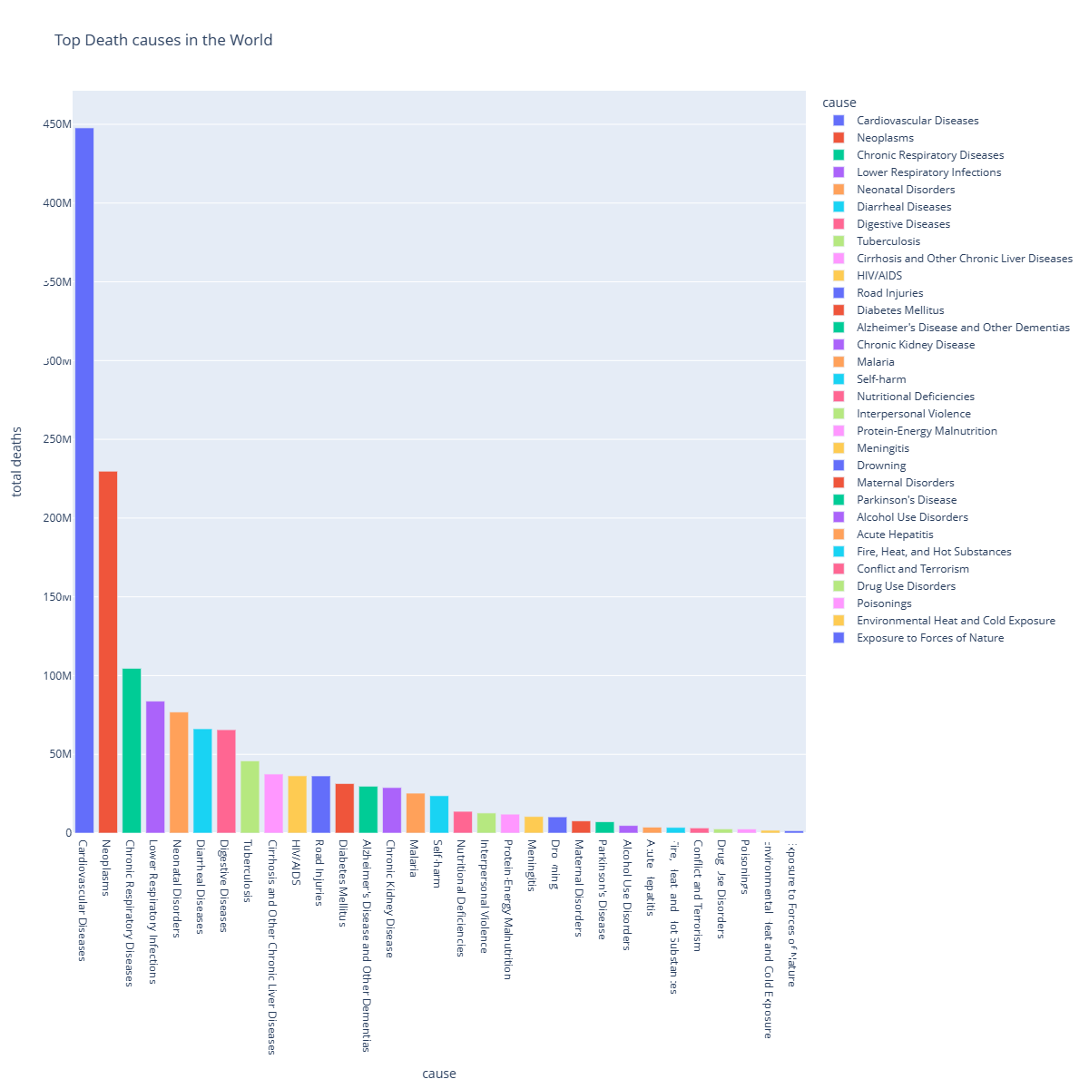
Top 5 Causes of Death

Slide 13
Top 5 Causes of Death
As you can see here, the top causes of deaths can be seen in the above graph however the rate of deaths due to cardiovascular diseases are on the top.
Top 5 Causes for High individual Death counts are:
1. Cardiovascular Diseases
2. Neoplasms
3. Chronic Respiratory Diseases
4. Lower Respiratory Infections
5. Neonatal Disorders

Slide 14
Lowest 5 causes for death
Last five Causes for Highest Death Counts Are:
1. Exposure to Forces of nature
2. Environmental Heat and cold exposure
3. Poisonings
4. Drug use disorders
5. Conflict and terrorism

Slide 15
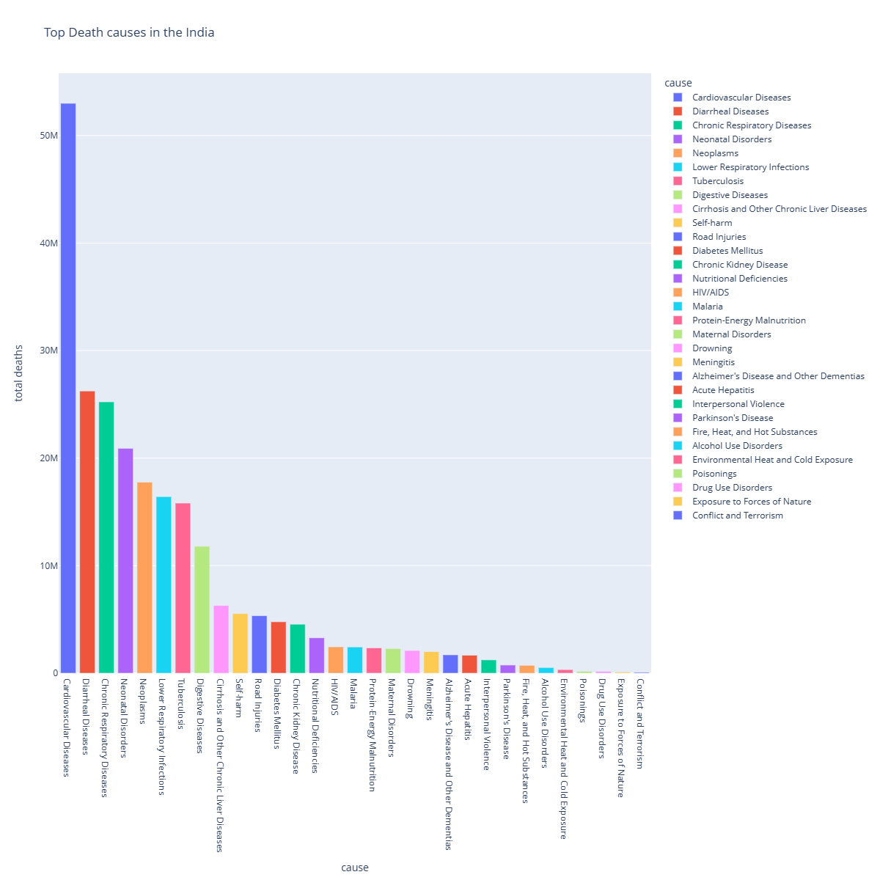
INDIA Death Causes Trend

Slide 16
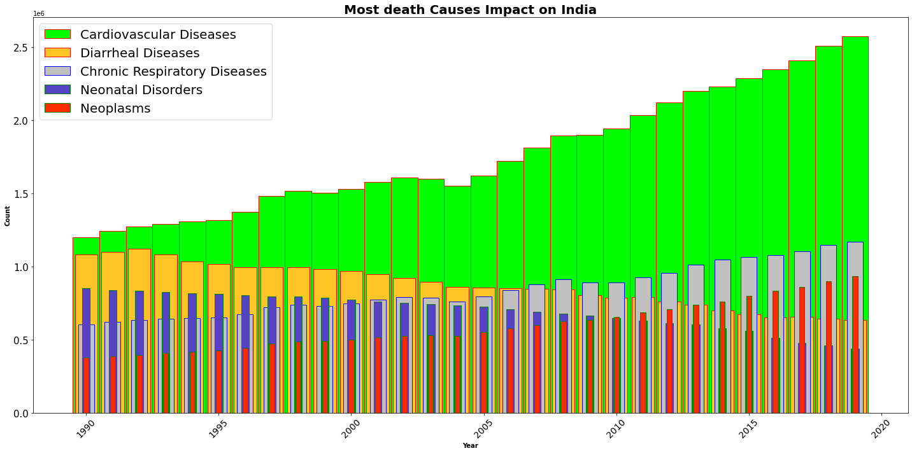
TOP 5 Causes trend in India
The Above graph shows how thefive causes of death in india is varying in the past 30 years top that
1. Cardiovascular Diseases are increasing in trend and rapidly increasing
2. Diarrheal Diseases are decreasing in trend
3. Chronic Respiratory diseases are also in increasing trend
4. Neonatal Disorders deaths are decreasing in trend
5. Neoplasms deaths are steadily increasing

Slide 17
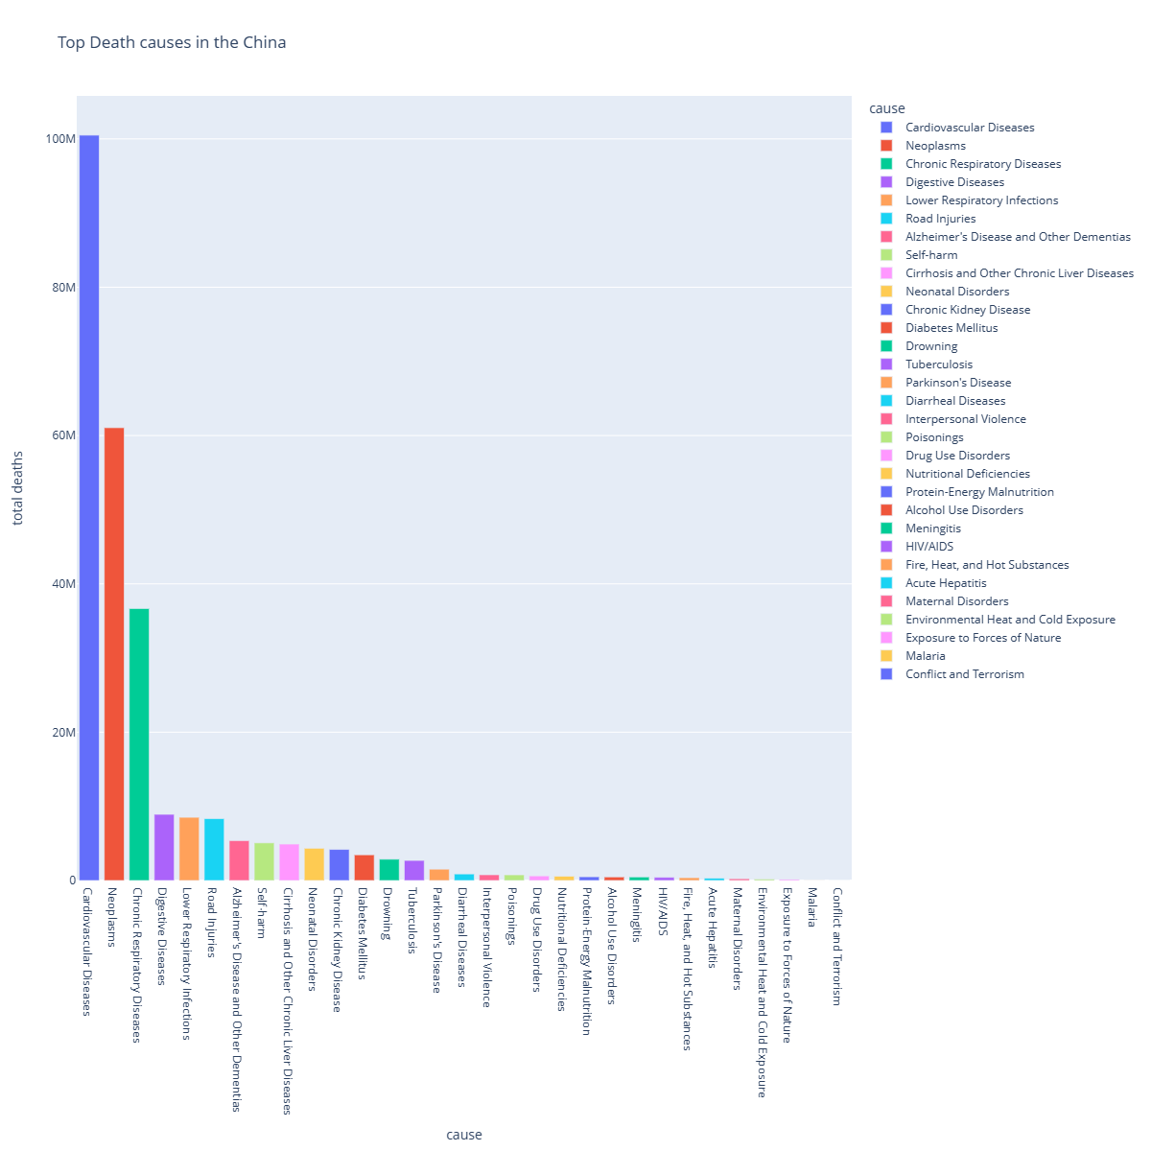
China Death Causes Trend

Slide 18
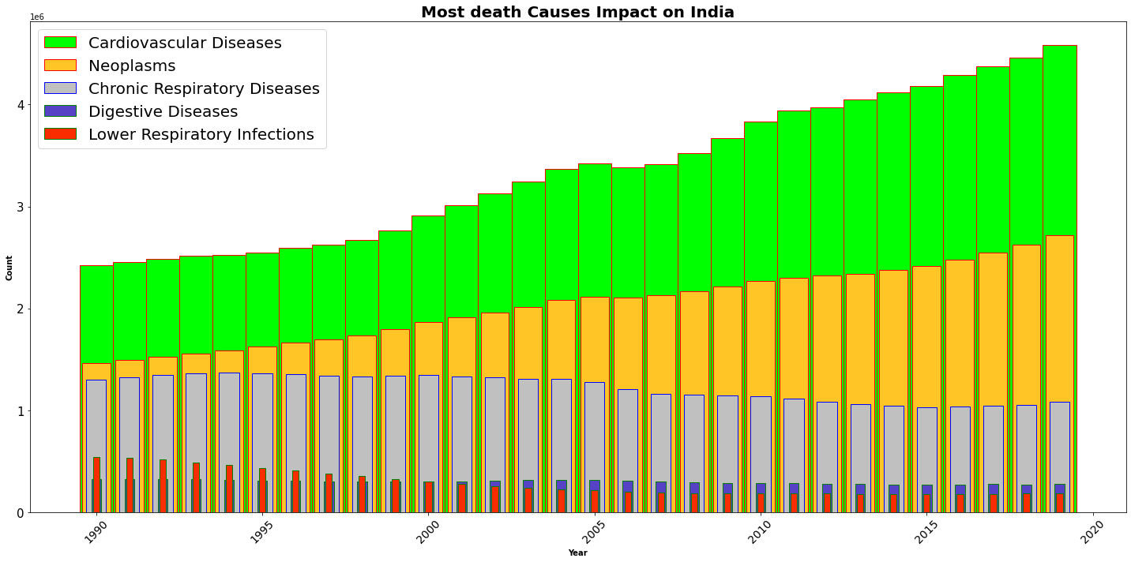
Death Causes impact on China
The Above plot shows the trend of top 5 diseases effect on China in the past 30 years
1. cardiovascular diseases are increasing in trend and rapidly increasing 2. Neoplasms deaths are steadily increasing 3. Chronic Respiratory diseases are in decreasing trend 4. Digestive diseases are in a stable trend
5. Lower Respiratory infection deaths are also in decreasing trend

Slide 19
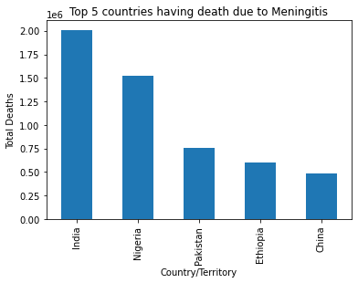
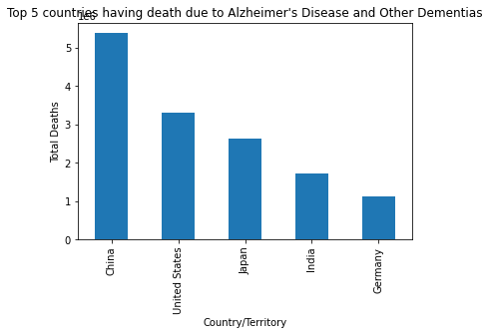
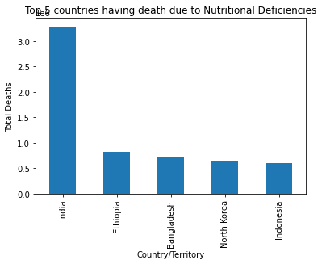
Few Trend Lines for Some Diseases

Slide 20
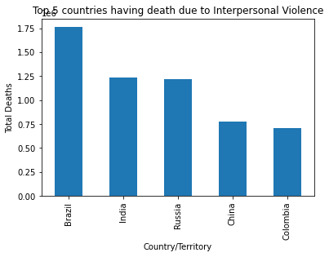
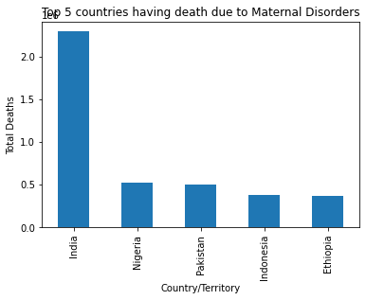
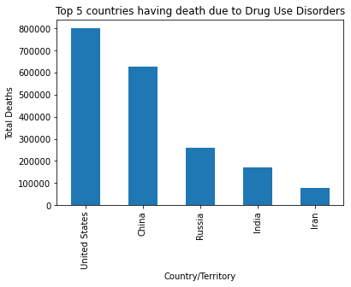
Few Trend Lines for Some Diseases

Slide 21
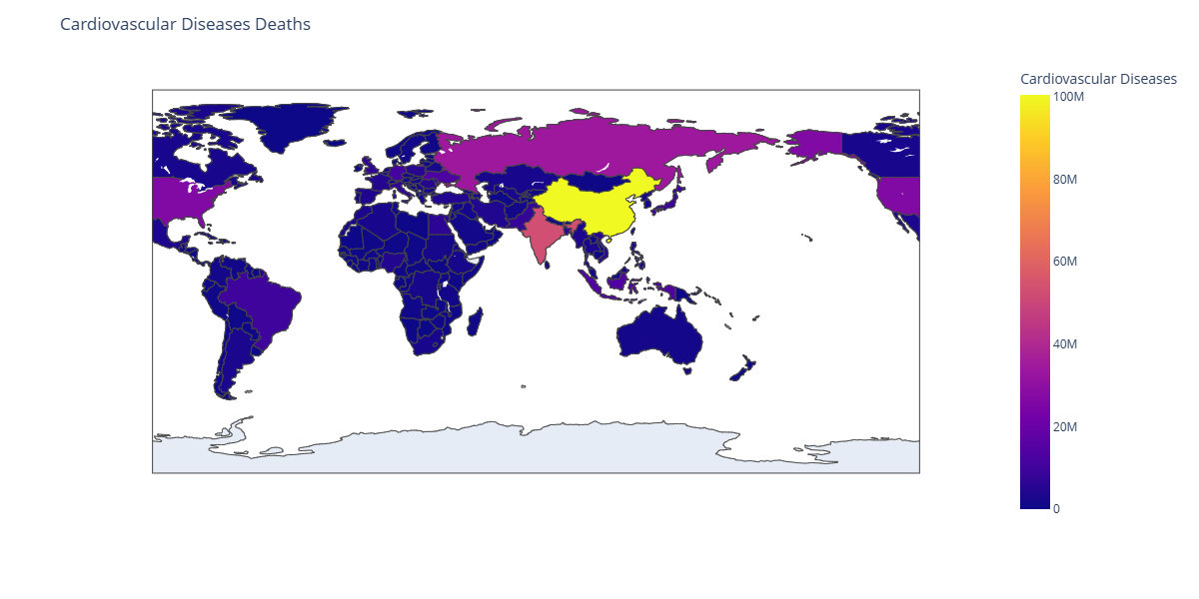
Cardiovascular Deaths

Slide 22
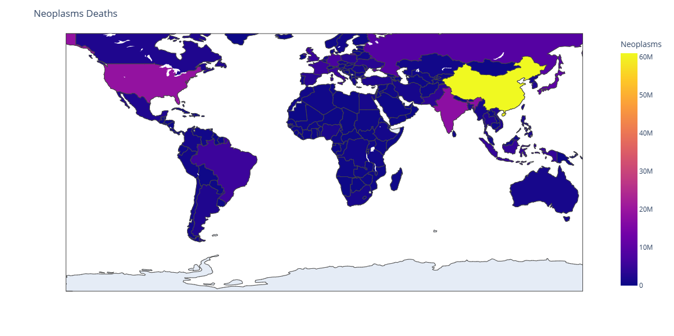
Neoplasms Deaths

Slide 23
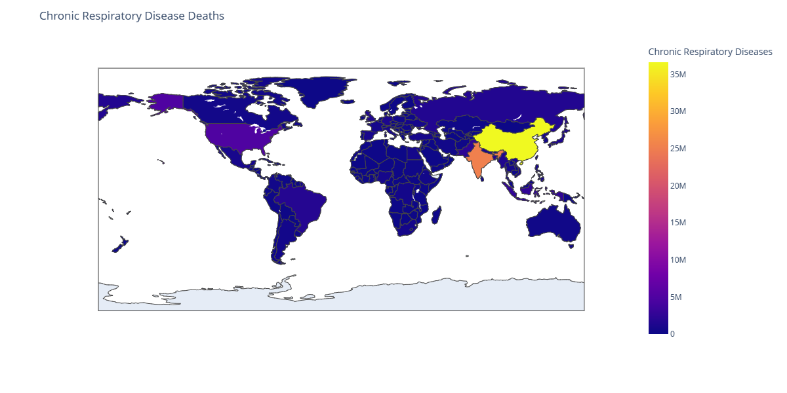
Chronic Respiratory Diseases

Slide 24
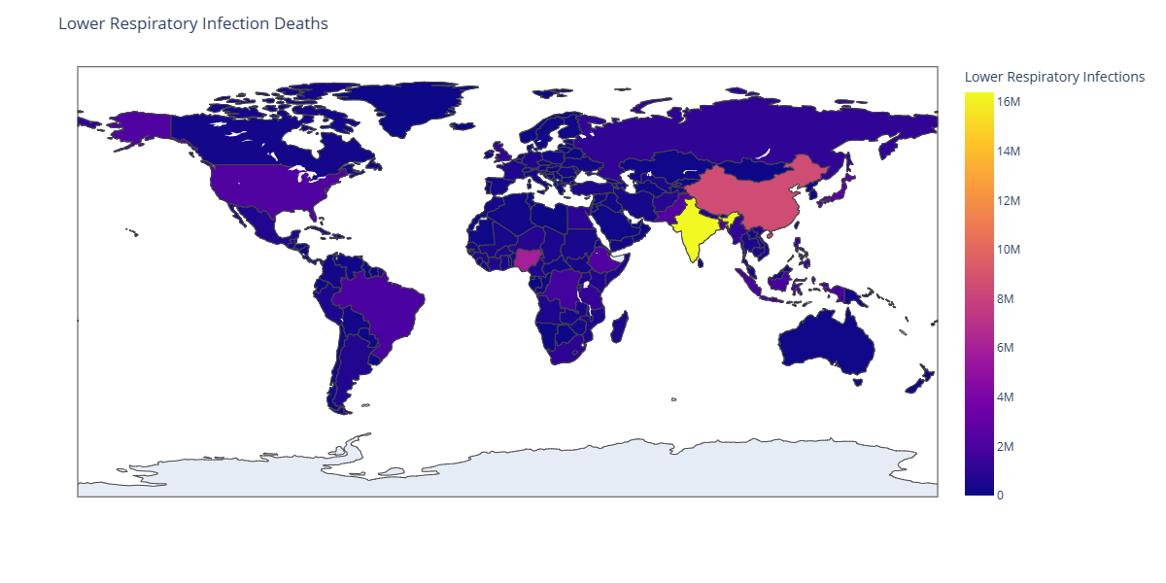
Lower Respiratory Infection Deaths

Slide 25
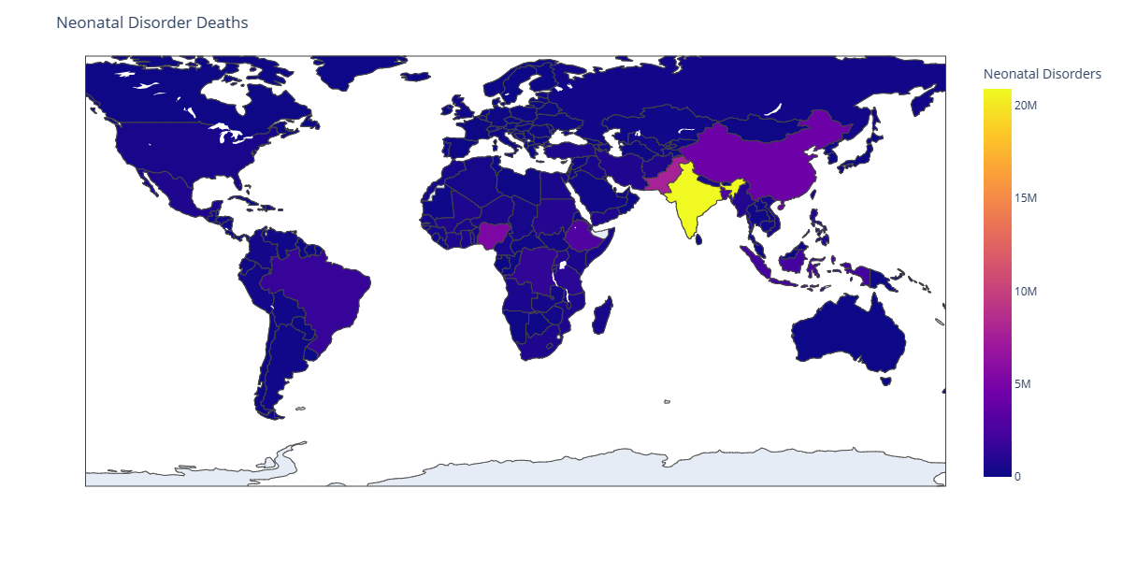
Neonatal Disorder Deaths

Slide 26
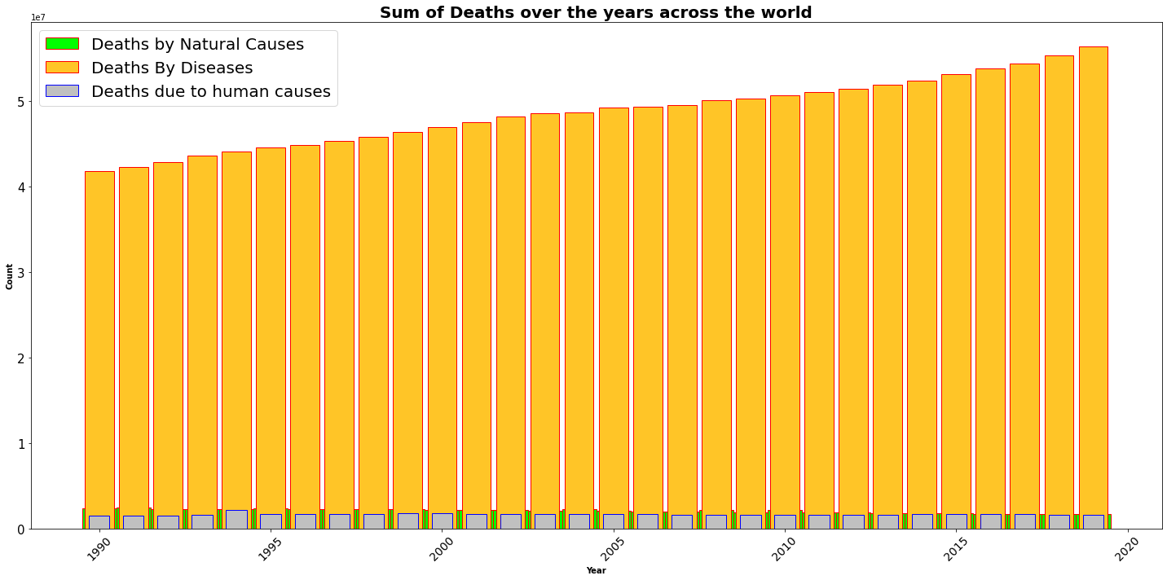
Sum of deaths in three different categories

Slide 27
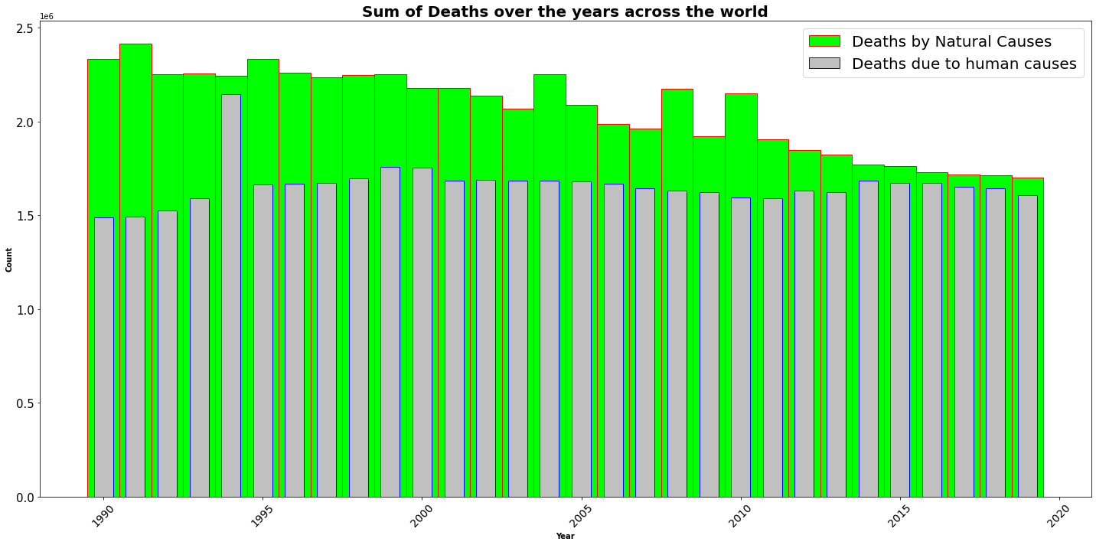
Natural vs Human Causes

Slide 28
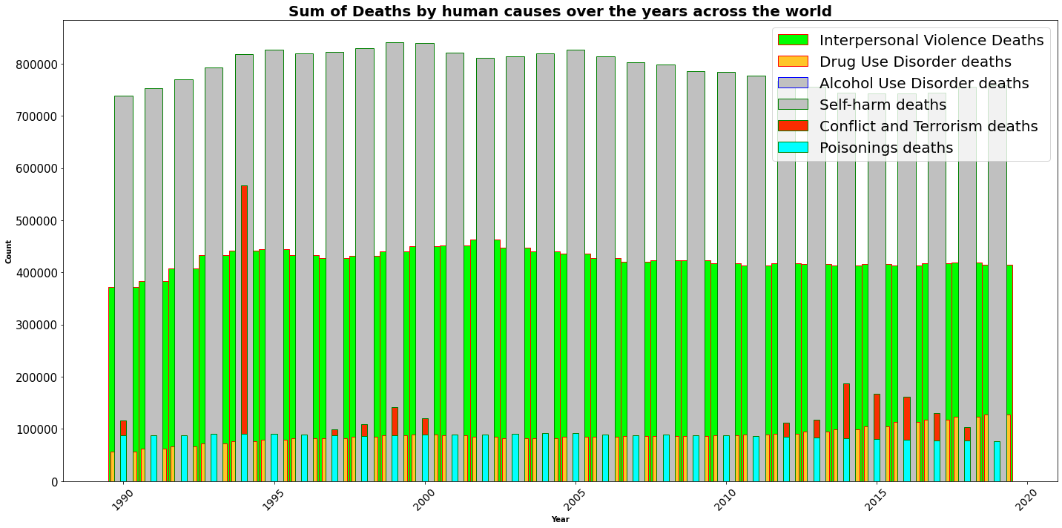
Human Causes graph

Slide 29
Conclusion
The following Diseases were in continuously decreasing trend since last 30 Years:
Meningtis Nutritional Deficiencies Drowining
Maternal Disorders Tuberculosis Lower Respiratory infections
Neonatal Disorders Diarrheal Disorders Poisonings
Protein Energy Malnutrition Acute Hepatitis

Slide 30
Conclusion
The following Diseases were in continuously increasing trend since last 30 Years:
Alzheimer’s disorders
Parkinson’s diseases
Drug use disorders
Cardiovascular Disorders
Alcohol use disorders
Neoplasms
Diabetes Related
Chronic kidney Diseases
Road Injuries
Chronic Respiratory diseases
Digestive diseases
Cirrhosis and Other Chronic Liver Diseases

Slide 31
Conclusion
HIV/AIDS was increased during 2005 and now its in decreasing trend.
I found out that there are many diseases which continiously increasing such as Neoplasms,Diabetes,Cardiovascular Diseases,Digestive disorder and Alzheimer. I Found out that there are many disease which are continously decreasing too such as Acute Hepatitis,Diarrheal Diseases,Nutritional Diseases and Meningitis. Parkinson Diseases seems to be constants till 1990 to 1993 after that no data is present for the same. We can see that in all the given years i.e 1990 to 2019 ,Road accident have taken Maximum lifes and the least can death can be seen in Exposure to force of Nature. In case of Death by crime ,self-harm and Accident -> Maximum death have been taken place by Conflict and Terroism and the second highest death have been recorded by -Interpersonal Violence.

Slide 32


Thank You
Nagavenkateswara Rao Illa
venkatmec132@gmail.com

